Slide 1
Cost Benefit Analysis (CBA) in Plantation Crops
CBA is a financial tool used to compare the costs and benefits of a project to determine if it is worth pursuing.
Importance
Helps farmers and investors in plantation crops (e.g., tea, coffee, or macadamia) to make informed decisions by assessing the profitability.
Components of Cost-Benefit Analysis
Costs
Fixed Costs (FC): Do not change with production levels (e.g., land, irrigation system)
Variable Costs (VC): Depend on production levels (e.g., seeds, fertilizers, labour).
Benefits
Revenue from selling yield

Slide 2
Steps in Conducting CBA
Identify Costs and Benefits
Example: FC = MWK 7,000,000;
VC = MWK 3,500,000
Revenue = MWK 15,000,000
Total Costs = FC + VC = MWK 7,000,000 + MWK 3,500,000 = MWK 10,500,000
Net Benefits = Revenue - Total Costs = MWK 15,000,000 - MWK 10,500,000 = MWK 4,500,000
Future cash flows should be discounted to reflect their present value
why?

Slide 3
Discounting is a financial technique used to adjust the value of future cash flows (like costs or benefits) to reflect their value in today's terms, known as present value.
why it's important, below are answers
Time Value of Money:
Money today is worth more than the same amount in the future because money can be invested to earn interest or returns.
Imagine you are deciding whether to invest MWK 40,000,000 today for a project that will give you MWK 12,000,000 per year for 5 years.
If you don't discount, it may seem like a simple comparison: MWK 12,000,000 × 5 = MWK 60,000,000 in total benefits, which looks like a good profit over MWK 40,000,000.
However, receiving MWK 12,000,000 over time is not the same as receiving MWK 60,000,000 upfront today.
Discounting adjusts these future cash flows to reflect their true value in today's terms, so you can make an informed decision.

Slide 4
Time value of money – Money today can be invested to earn interest, so it is worth more than the same amount received in the future.
Inflation – Future money will buy less because prices tend to rise over time.
Fair decision-making – It allows businesses, governments, and individuals to fairly compare projects or investments that have costs and benefits spread over many years.
Resource allocation – Helps identify which projects give the best return or value when resources are limited.
Risk and Uncertainty There's also more risk and uncertainty with future cash flows.
The further into the future you go, the more things can change (inflation, market fluctuations, risks).
Discounting adjusts for this uncertainty by lowering the present value of future money.
When we discount future cash flows, we reduce them based on a discount rate (usually a percentage like 5%).

Slide 5
For example, MWK 12,000,000 in five years is not worth the same as MWK 12,000,000 today. By discounting it, we calculate its value in today's terms to determine whether the project is still profitable when considering time.
EXAMPLE
Calculating the Net Present Value (NPV) of a macadamia plantation.
Initial Investment (land, seedlings, irrigation system): MWK 40,000,000
Annual Benefits (revenue from harvest): MWK 12,000,000 for 5 years
Discount Rate: 5% (This adjusts future values to the present)
Discounting: In order to find the present value of future benefits

Slide 6
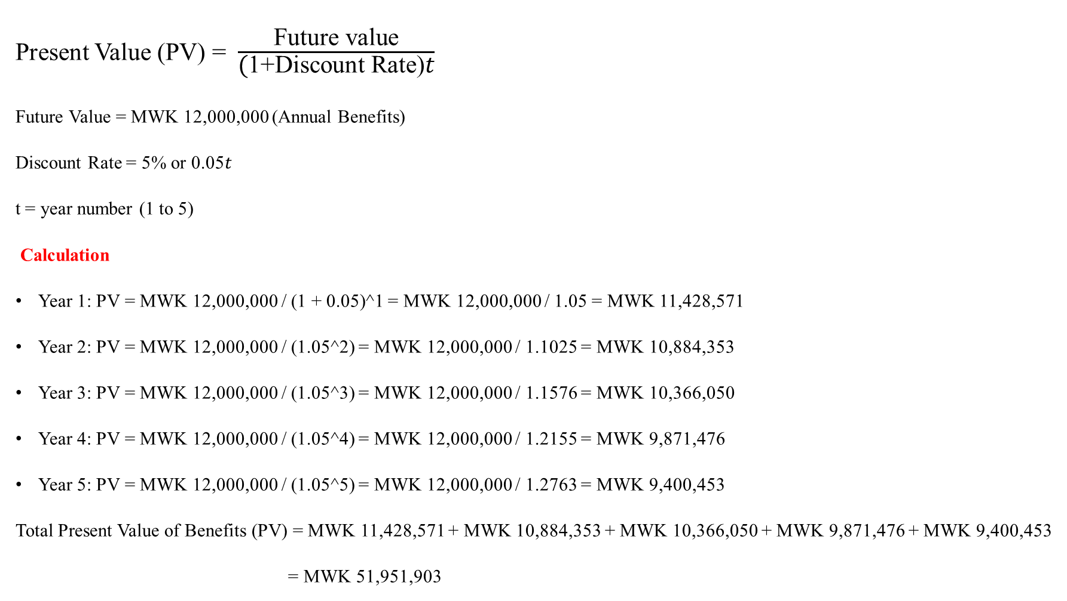
Present Value (PV) = $\frac{\text{Future} \text{value}}{\text{(}\text{1+}\text{Discount} \text{Rate}\text{)}\text{t}}$
Future Value = MWK 12,000,000 (Annual Benefits)
Discount Rate = 5% or 0.05𝑡
t = year number (1 to 5)
Calculation
Year 1: PV = MWK 12,000,000 / (1 + 0.05)^1 = MWK 12,000,000 / 1.05 = MWK 11,428,571
Year 2: PV = MWK 12,000,000 / (1.05^2) = MWK 12,000,000 / 1.1025 = MWK 10,884,353
Year 3: PV = MWK 12,000,000 / (1.05^3) = MWK 12,000,000 / 1.1576 = MWK 10,366,050
Year 4: PV = MWK 12,000,000 / (1.05^4) = MWK 12,000,000 / 1.2155 = MWK 9,871,476
Year 5: PV = MWK 12,000,000 / (1.05^5) = MWK 12,000,000 / 1.2763 = MWK 9,400,453
Total Present Value of Benefits (PV) = MWK 11,428,571 + MWK 10,884,353 + MWK 10,366,050 + MWK 9,871,476 + MWK 9,400,453
= MWK 51,951,903

Slide 7
Net Present Value (NPV) Calculation
NPV = Total Present Value of Benefits - Total Investment
NPV=MWK51,951,903−MWK40,000,000
= MWK11,951,903
Interpretation of Results
Since the NPV = MWK 11,951,903, the project is financially viable and profitable
Positive NPV: This means the expected benefits outweigh the costs, and the project should be pursued.
Negative NPV: If this were negative, the project wouldn’t be worth investing in financially.

